Slide 1
placeholders
Taught by Yossef Ayman Zedan

Slide 2
About
Placeholders can be used to enhance the experience of your application. They’re built only with HTML and CSS, meaning you don’t need any JavaScript to create them. You will, however, need some custom JavaScript to toggle their visibility. Their appearance, color, and sizing can be easily customized with our utility classes.

Slide 3
Example
In the example below, we take a typical card component and recreate it with placeholders applied to create a “loading card”. Size and proportions are the same between the two.
<div class="card">
<img src="..." class="card-img-top" alt="...">
<div class="card-body">
<h5 class="card-title">Card title</h5>
<p class="card-text">Some quick example text to build on the card title and make up the bulk of the card's content.</p>
<a href="#" class="btn btn-primary">Go somewhere</a>
</div>
</div>

Slide 4
Example
<div class="card" aria-hidden="true">
<img src="..." class="card-img-top" alt="...">
<div class="card-body">
<h5 class="card-title placeholder-glow">
<span class="placeholder col-6"></span>
</h5>
<p class="card-text placeholder-glow">
<span class="placeholder col-7"></span>
<span class="placeholder col-4"></span>
<span class="placeholder col-4"></span>
<span class="placeholder col-6"></span>
<span class="placeholder col-8"></span>
</p>
<a href="#" tabindex="-1" class="btn btn-primary disabled placeholder col-6"></a>
</div>
</div>

Slide 5
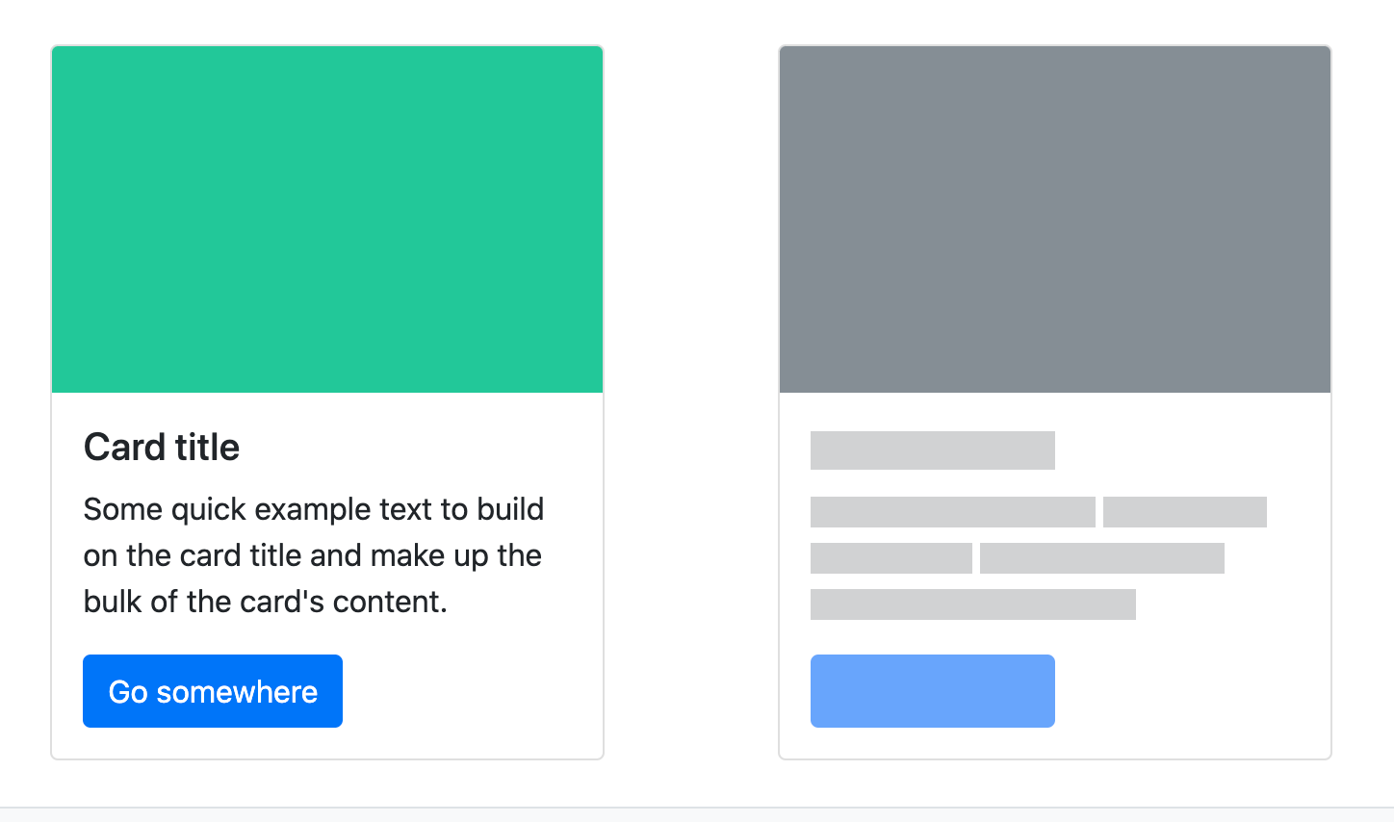
Example

Slide 6
How it works
Create placeholders with the .placeholder class and a grid column class (e.g., .col-6) to set the width. They can replace the text inside an element or as be added as a modifier class to an existing component.
Bootstrap applies additional styling to .btns via ::before to ensure the height is respected. You may extend this pattern for other situations as needed, or add a &nbsp; within the element to reflect the height when actual text is rendered in its place.
<p>
<span class="placeholder col-6"></span>
</p>
<a href="#" class="btn btn-primary disabled placeholder col-4"></a>

Slide 7

How it works

Slide 8
Width
You can change the width through grid column classes, width utilities, or inline styles.
<span class="placeholder col-6"></span>
<span class="placeholder w-75"></span>
<span class="placeholder" style="width: 25%;"></span>

Slide 9

Width

Slide 10
Color
By default, the placeholder uses currentColor. This can be overriden with a custom color or utility class.
<span class="placeholder col-12"></span>
<span class="placeholder col-12 bg-primary"></span>
<span class="placeholder col-12 bg-secondary"></span>
<span class="placeholder col-12 bg-success"></span>
<span class="placeholder col-12 bg-danger"></span>
<span class="placeholder col-12 bg-warning"></span>
<span class="placeholder col-12 bg-info"></span>
<span class="placeholder col-12 bg-light"></span>
<span class="placeholder col-12 bg-dark"></span>

Slide 11

Color

Slide 12
Sizing
The size of .placeholders are based on the typographic style of the parent element. Customize them with sizing modifiers: .placeholder-lg, .placeholder-sm, or .placeholder-xs.
<span class="placeholder col-12 placeholder-lg"></span>
<span class="placeholder col-12"></span>
<span class="placeholder col-12 placeholder-sm"></span>
<span class="placeholder col-12 placeholder-xs"></span>

Slide 13
Animation
Animate placehodlers with .placeholder-glow or .placeholder-wave to better convey the perception of something being actively loaded.
<p class="placeholder-glow">
<span class="placeholder col-12"></span>
</p>
<p class="placeholder-wave">
<span class="placeholder col-12"></span>
</p>

Slide 14

Animation

